Slide 1
Cardiorespiratory Assessment in Clinical Conditions
Bronchiectasis, Emphysema, Chronic Bronchitis, Cystic Fibrosis, Surgical Conditions, and Heart Failure
BSc & MSc Physiotherapy Lecture

Slide 2
Learning Outcomes
By the end of this session, students will be able to:
• Understand the principles of cardiorespiratory assessment.
• Apply assessment techniques to specific clinical conditions.
• Interpret physiological findings and relate to pathology.
• Identify physiotherapy priorities in complex multimorbidity cases.
• Use evidence-based frameworks for respiratory assessment.

Slide 3
Overview of Cardiorespiratory Assessment
• Importance of assessment in physiotherapy practice.
• Integration of subjective and objective findings.
• Use of frameworks: SOAP, ICF, or hypothesis-oriented reasoning.
• Link between pathophysiology, symptoms, and function.

Slide 4
Subjective Assessment
• Presenting complaint (breathlessness, cough, sputum).
• History of presenting condition and past medical history.
• Functional impact (ADL, exercise tolerance).
• Medications, smoking history, and psychosocial factors.

Slide 5
Objective Assessment
• Observation: posture, breathing pattern, cyanosis, accessory muscles.
• Palpation: chest expansion, tactile fremitus, tracheal position.
• Percussion: resonance, dullness, hyper-resonance.
• Auscultation: vesicular, crackles, wheeze, diminished breath sounds.

Slide 6
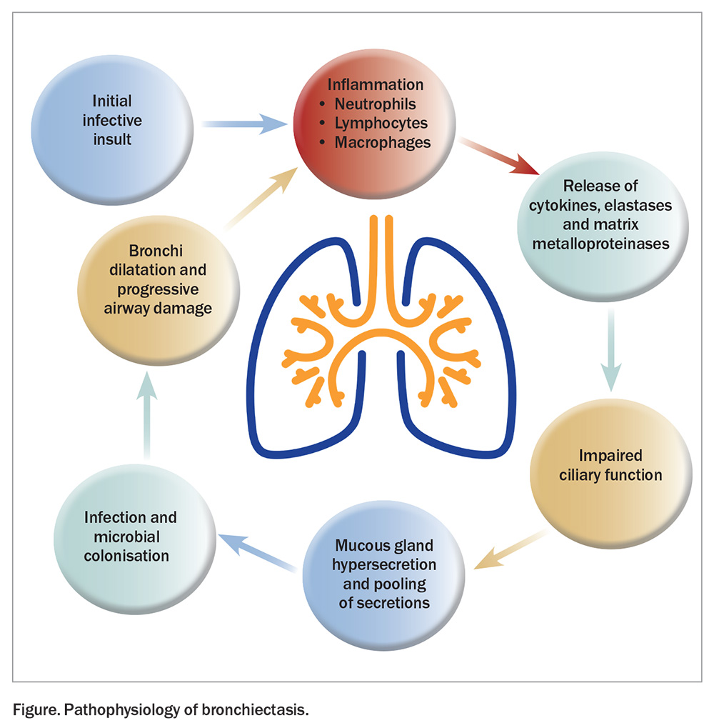
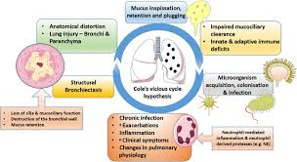
Pathophysiology of Bronchiectasis
Definition: Chronic irreversible dilation of bronchi due to wall destruction.
Key Mechanism: Infection → Inflammation → Structural Damage → Impaired Clearance → Recurrent Infection.
Neutrophilic inflammation leads to protease release and mucus hypersecretion.
Airway remodeling causes thickening, fibrosis, and airflow obstruction.

Slide 7
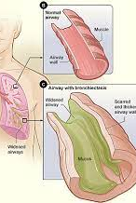
Pictorial Depiction of Pathophysiology
Include diagrams:
- Normal vs. bronchiectatic airway (mucus plugs, ciliary damage).
- Vicious cycle: infection–inflammation–damage loop.
- Cross-section showing airway wall thickening and mucus pooling.

Slide 8
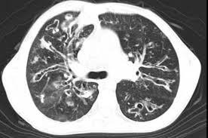
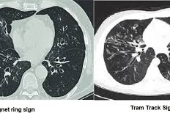
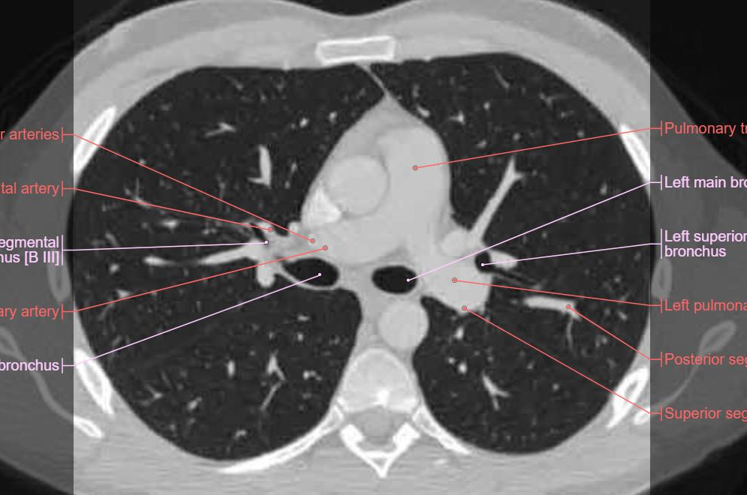
Radiological Features (CT Imaging)
Gold Standard: HRCT.
Key Signs:
- Signet ring sign (dilated bronchus > artery).
- Tram-track sign (parallel lines).
- Tree-in-bud (small airway impaction).
Types: Cylindrical, varicose, cystic bronchiectasis.
Distribution: Upper (CF), lower (aspiration), central (ABPA).

Slide 9
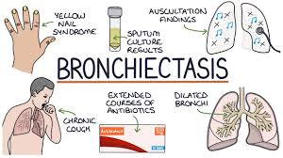
Respiratory Assessment
History: Frequency of infections, sputum, dyspnoea, exercise tolerance.
Observation: Posture, accessory muscle use, clubbing, cyanosis.
Inspection: Chest wall movement, scars, hyperinflation.
Palpation & Percussion: Chest expansion, resonance changes.
Auscultation: Coarse crackles, rhonchi, wheeze.
Functional Tests: 6MWT, MRC Dyspnoea, CAT score.

Slide 10
Bronchiectasis – Physiotherapy Assessment
• Assess sputum load, cough effectiveness, infection status.
• Observe posture, chest expansion, and exercise tolerance.
• Outcome measures: sputum volume, 6MWT, MRC dyspnoea scale.
• Prioritise airway clearance and energy conservation education.

Slide 11
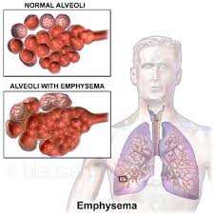
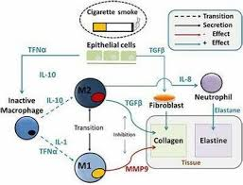
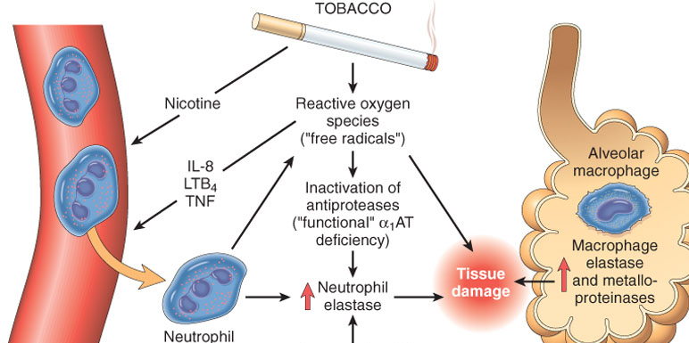
Emphysema – Pathophysiology & Assessment
• Alveolar wall destruction → reduced elastic recoil, hyperinflation.
• Clinical: barrel chest, reduced breath sounds, pursed-lip breathing.
• Spirometry: ↓FEV₁, ↑TLC, ↓DLCO.
• Assess dyspnoea, exercise capacity, and secretion management needs.

Slide 12
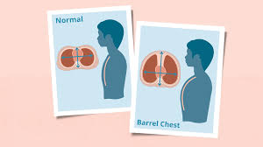
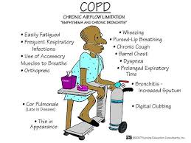
Clinical features and assessment

Slide 13
Chronic Bronchitis – Assessment Focus
• Productive cough for ≥3 months in 2 consecutive years.
• Clinical: wheeze, cyanosis, peripheral oedema (blue bloater).
• Objective: coarse crackles, sputum assessment, auscultation findings.
• Priorities: airway clearance, breathing control, exercise tolerance.

Slide 14
Cystic Fibrosis – Overview
• Autosomal recessive disorder causing thick, sticky mucus production.
• Multisystem disease: respiratory, GI, reproductive.
• Assess sputum viscosity, infection frequency, nutritional status.
• Physiotherapy: airway clearance, exercise prescription, inhalation therapy.

Slide 15
Surgical Conditions – Assessment & Risks
• Post-op risks: atelectasis, infection, secretion retention, pain.
• Pre-op assessment: smoking status, baseline lung function.
• Post-op assessment: pain score, cough effectiveness, SpO₂, mobility.
• Priorities: breathing exercises, early mobilisation, airway clearance.

Slide 16
Heart Failure – Pathophysiology & Assessment
• Pump failure → pulmonary congestion and systemic hypoperfusion.
• Symptoms: orthopnoea, PND, fatigue, ankle oedema.
• Signs: crackles, JVP, hepatomegaly, weight gain.
• Physiotherapy: low-intensity exercise, pacing, education, monitoring.

Slide 17
Multimorbidity – Physiotherapy Implications
• Common overlap: COPD + heart failure, diabetes, obesity.
• Requires integrated assessment and prioritisation of treatment goals.
• Red flag awareness: unstable vitals, acute decompensation.
• Holistic management and MDT collaboration essential.

Slide 18
Summary & Integration
• Systematic cardiorespiratory assessment underpins clinical reasoning.
• Identify pathophysiological patterns across conditions.
• Link findings to prioritised physiotherapy goals.
• Promote patient-centred, evidence-based care.

